Slide 1
Majestic Theatre Centre
Venue Performance Analysis
Majestic Theatre (AEG) vs. Magic Stick (In-House) | 2019 & 2022–2026 | 845 Shows
Majestic Theatre:
AEG-booked | 1,100 capacity | 446 shows analyzed
Magic Stick:
In-house booked | 775 capacity | 399 shows analyzed
Years covered:
2019 (pre-COVID baseline) + 2022–2026
Genre coverage:
8 genres tagged across 845 shows
Confidential — Internal Use Only

Slide 2
Venue Comparison — Key Metrics
Per-show averages across all available years
Metric
Majestic Theatre
Magic Stick
Note
Avg Capacity Rate
67%
54%
Majestic fills more seats per show
Avg Gross Ticket Revenue
$28,204
$13,031
Majestic ~2x — larger venue, bigger acts
Avg Bar Revenue
$8,383
$8,440
Nearly identical despite different venue size
Avg Alcohol $/Guest
$21.61
$20.69
Similar per-capita spend
Avg Band Guarantee
$14,239
$7,699
AEG books higher-cost talent
Loss-Making Shows (gate)
35.7%
52.9%
Magic Stick loses gate on more shows
Key insight: Bar revenue is nearly identical across both venues ($8,383 vs $8,440) despite Majestic being 42% larger — Magic Stick generates equivalent bar volume with fewer people in the room.

Slide 3
Profit Comparison — After AEG Revenue Split
What MTC actually keeps per show after applying the 50/30 partner arrangement
Majestic Theatre (MTC Share)
Magic Stick (100% retained)
50% of gate + 70% of bar retained by MTC
No partner split — MTC keeps all revenue
Avg Gate Settlement (MTC 50%)
Avg Gate Settlement (100%)
$4,156
$1,061
Avg Bar Revenue (MTC 70%)
Avg Bar Revenue (100%)
$5,868
$8,440
Avg Show Gross Proceeds
Avg Show Gross Proceeds
$5,755
$9,283
Key finding: Magic Stick generates 61% more gross proceeds per show for MTC ($9,283 vs $5,755). After applying a 28% bar cost estimate (matching Majestic's documented rate), Magic Stick still leads by ~23%. The in-house model captures revenue the AEG arrangement shares with a partner. Both models offer distinct advantages — Majestic benefits from AEG's booking infrastructure and national act relationships.

Slide 4
Year-Over-Year Performance
2019 pre-COVID baseline vs. 2022–2026 recovery
Majestic: steady growth post-COVID — ticket revenue up 94% from 2019 to 2026, capacity rates hitting 82% in 2026. Magic Stick: softer capacity recovery (dip to 44% in 2023) but strong 2026 uptick to 69%.

Slide 5
Pre-COVID Baseline vs. Post-COVID Recovery
2019 performance benchmarked against 2022–2026 averages
Metric
Majestic 2019
Majestic 2022+
Magic Stick 2019
Magic Stick 2022+
Avg Capacity Rate
61%
69%
62%
52%
Avg Gross Ticket Revenue
$19,844
$30,023
$12,582
$13,111
Avg Bar Revenue
$5,651
$9,007
$8,582
$8,413
Avg Alcohol $/Guest
$9.42
$24.27
$16.79
$21.39
• Majestic post-COVID: ticket revenue +51%, bar revenue +59%, alcohol/guest +157%
• Magic Stick: capacity rates declined post-COVID but alcohol spend per guest up 27%
• Majestic's alcohol/guest figure jumped from $9.42 to $24.27 — most striking shift in the dataset

Slide 6
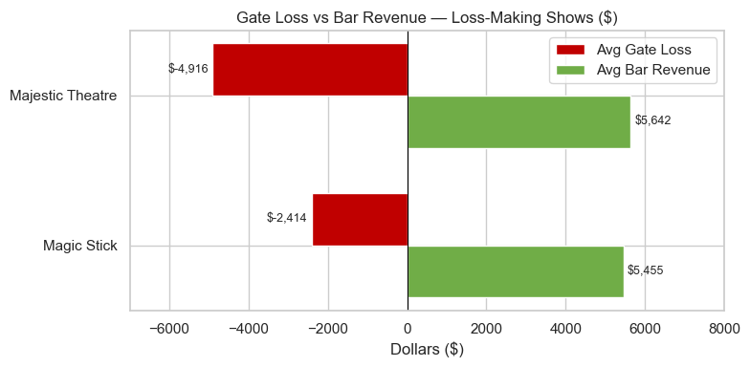
Loss-Making Shows & Bar Revenue Offset
Gate losses are common — bar revenue covers them at both venues
Magic Stick — Loss Rate
Majestic — Loss Rate
Magic Stick avg gate loss
Majestic avg gate loss
52.9%
35.7%
$(2,414)
$(4,916)
211 of 399 shows
159 of 446 shows
bar offset: $5,455
bar offset: $5,642
• Bar revenue more than doubles the avg gate loss at Magic Stick (2.3x coverage)
• Majestic bar barely covers gate losses — thin cushion, ~$726 net positive on average
• Pop is the only genre where bar revenue does NOT cover average gate losses (net -$1,822)
• Electronic/Dance has highest gate loss rate (51.9%) but bar covers by 2.3x

Slide 7
Movement Festival Weekend
Memorial Day weekend — the single biggest revenue driver of the year
Movement Shows in Dataset
Avg Capacity Rate
Avg Gross Ticket Revenue
Avg Bar Revenue
28
101%
$36,764
$16,352
across 2019–2026
vs 60% rest of year
vs $20,539 rest of year
vs $8,154 rest of year
Movement Weekend Shows
Movement vs. Rest of Year
Year
Venue
Headliner
Metric
Movement
Other
2019
Magic Stick
Walker And Royce / Detroit Love / Origins
Capacity Rate
101%
60%
2022
Magic Stick
Claude Von Stroke / Shiba San / Inner City
Ticket Revenue
$36,764
$20,539
2024
Magic Stick
Dr Fresch / Meduza / Kevin Saunderson / In The Mood
Bar Revenue
$16,352
$8,154
2025
Magic Stick
Max Styler / Defected / Odd Mob / Repopulate Mars
Alcohol $/Guest
$18.88
$21.25
2026
Magic Stick
Chris Lorenzo / Odd Mob / Kevin Saunderson / Repopulate Mars
Note: Alcohol/guest is slightly lower during Movement despite higher crowds — volume (not per-cap) drives bar revenue. Booked exclusively by Paxahau (Tom Pattyn).

Slide 8
Day of Week & Seasonal Patterns
Booking distribution and revenue performance by day
• Magic Stick is predominantly a Fri/Sat venue (280 of 399 shows, 70%)
• Majestic books heavily midweek (Tue–Thu: 184 shows) — AEG's draw enables weeknight bookings
• Friday and Saturday generate highest bar revenue ($9,391 / $9,251) — peak drinking nights
• Tuesday has the highest avg capacity rate (68%) — likely selective, well-curated midweek bookings

Slide 9
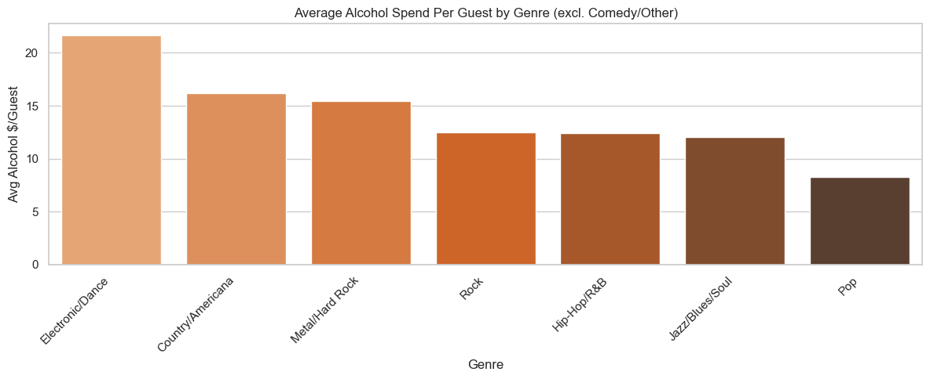
Genre Analysis — Performance by Music Type
Capacity rates, revenue, and drinking behavior by genre
Genre
Loss Rate
Avg Gate Loss
Avg Bar Revenue
Bar covers losses?
Electronic/Dance
51.9%
$(2,837)
$6,529
Yes — 2.3x
Metal/Hard Rock
45.2%
$(4,674)
$5,519
Yes — $844 net
Country/Americana
42.1%
$(5,502)
$8,090
Yes — $2,588 net
Rock
37.8%
$(3,967)
$4,801
Yes — $834 net
Pop
37.5%
$(5,216)
$3,394
No — $(1,822) net
Hip-Hop/R&B
32.4%
$(3,133)
$3,492
Yes — $358 net

Slide 10
Repeat Artist Analysis
69 artists have played more than once — do they outperform first-time bookings?
Repeat Artists (2+ shows)
Repeat Avg Capacity Rate
Capacity Rate Advantage
Statistically Significant
69
65.3%
+5.2 pts
Trending
of 767 unique artists
vs 60.1% first-time
p-value: 0.060
just above 0.05 threshold
TOP 10 REPEAT ARTISTS — BY CAPACITY RATE
Artist
Shows
Cap Rate
Avg Ticket Revenue
Avg Bar Revenue
Avg Gross Proceeds
Odd Mob
2
127%
$57,369
$23,200
$43,734
Claude Von Stroke
3
107%
$35,735
$20,973
$30,169
Nora En Pure
2
106%
$37,469
$21,226
$27,145
Omnom
2
106%
$27,064
$20,991
$29,342
Kevin Saunderson
3
103%
$41,122
$22,765
$31,194
Nora en Pure (prior)
2
99%
$33,002
$25,400
$27,451
Repopulate Mars
3
97%
$31,478
$14,092
$20,423
Noname
2
91%
$28,704
$4,348
$12,775
Mustard Plug
2
85%
$16,473
$10,884
$15,438
Afrobeats to World
3
75%
$16,368
$11,072
$15,801
Takeaway: Top repeat artists average 103% capacity vs 60% for first-timers — selective rebooking is supported by the data.

Slide 11
Repeat Artist Analysis — Bottom Performers
Artists who have played more than once but with low capacity rates
BOTTOM 10 REPEAT ARTISTS — BY CAPACITY RATE
Artist
Shows
Cap Rate
Avg Ticket Revenue
Avg Bar Revenue
Avg Gross Proceeds
Reality Gays
2
17%
$5,686
$1,916
$3,802
Spencer Brown
2
20%
$3,153
$3,529
$3,341
Simon Doty
2
22%
$3,779
$3,552
$3,666
Golden Features
2
23%
$4,943
$3,129
$4,036
Little Miss Nasty
2
25%
$7,176
$3,140
$5,158
Biscits
2
27%
$4,289
$6,444
$5,367
EDX
2
31%
$6,727
$9,476
$8,102
Marsh
2
35%
$6,437
$6,504
$6,471
Moon Boots
2
35%
$6,240
$6,477
$6,359
Kasbo
2
36%
$8,487
$5,997
$7,242
Recommendation: These artists should be evaluated individually before rebooking. Low capacity rates may reflect poor fit with the venue's audience, weak marketing, or one-time circumstances.

Slide 12
Top & Bottom Performing Shows
Highest revenue shows and largest gate losses
TOP 5 BY GROSS TICKET REVENUE
Artist / Event
Venue
Date
Tickets
Cap Rate
Gross Ticket Rev
They Might be Giants
Majestic
Apr 2026
1,772
81%
$103,353
Dogstar
Majestic
Dec 2023
1,115
101%
$82,908
Ninja Sex Party
Majestic
Apr 2025
1,115
101%
$74,948
Minus the Bear
Majestic
Nov 2025
1,138
103%
$74,600
JVKE
Majestic
Aug 2023
1,100
100%
$69,720
BOTTOM 5 BY GATE SETTLEMENT
Artist / Event
Venue
Date
Cap Rate
Gate Settlement
Bar Revenue
ALY & AJ
Majestic
Oct 2025
73%
$(19,408)
$7,678
Bayside (2 nights)
Majestic
Apr 2025
42%
$(18,744)
$12,751
The Rapture
Majestic
Oct 2025
16%
$(17,865)
$3,014
Noah Cyrus
Majestic
Oct 2025
47%
$(17,084)
$6,394
Black Xmas
Majestic
Dec 2023
93%
$(15,629)
$26,652
Note: Black Xmas (Dec 2023) had 93% capacity and a $26,652 bar revenue despite a $(15,629) gate loss — highest bar revenue in the bottom-5, illustrating the bar-offset dynamic.

Slide 13
Key Findings & Strategic Implications
What the data tells us
01
Magic Stick nets more for MTC per show
02
Bar revenue is the profitability safety net
After the AEG split, Magic Stick generates ~61% more gross proceeds per show ($9,283 vs $5,755). After a 28% bar cost estimate, Magic Stick still leads by ~23%. Both models have distinct advantages — AEG brings booking infrastructure; in-house retains full margin.
At both venues, bar revenue covers average gate losses on loss-making shows. Magic Stick's cushion is larger (bar = 2.3x gate loss). Pop is the only genre where bar does not cover losses.
03
Movement Festival is a structural revenue outlier
04
Majestic shows a stronger post-COVID growth trajectory
Movement weekend averages 101% capacity, $36,764 ticket revenue, and $16,352 bar revenue — roughly double annual averages. Paxahau's partnership is critical to Magic Stick's annual budget.
Majestic capacity rates hit 82% in 2026 vs 61% in 2019. Ticket revenue up 94%. AEG enables consistent midweek programming that Magic Stick cannot match at scale.
05
Electronic/Dance dominates Magic Stick — Hip-Hop fills rooms best
06
Pricing does not track demand — opportunity exists
68% of Magic Stick shows are Electronic/Dance, but Hip-Hop/R&B has the highest avg capacity rate (67%). Electronic has the highest gate loss rate (51.9%) but strong bar offset.
No strong relationship between ticket price and capacity rate across either venue. High-confidence shows may be underpriced. Pricing strategy could be improved using advance ticket velocity as a demand signal.

Slide 14
Methodology & Next Steps
Data sources, limitations, and what's coming
Methodology
Limitations
• 845 shows from internal MTC spreadsheets (2019, 2022–2026)
• No actual COGS/labor data for Magic Stick — 28% is an estimate
• Magic Stick capacity standardized to 775 across all years
• 2019 Magic Stick promoter codes use a different legend (excluded from promoter analysis)
• Multi-night shows split into individual show-night rows
• 2026 data is partial through May — year averages may not be representative
• One show (Thursday, 2024) missing date due to source data entry error
• Genre tags assigned manually to all 767 unique artists
• 28% bar COGS/labor estimate applied to Magic Stick to match Majestic's documented cost rate
Next Steps
• AEG split: Majestic keeps 50% of gate + 70% of bar; AEG receives 50% gate + 30% bar
• Phase 2: Industry benchmarking vs. Pollstar / NIVA / Billboard Boxscore
• Phase 3: Predictive model (XGBoost / Random Forest) validated against Summer 2026 live shows
• Movement Festival = Memorial Day weekend (Fri–Mon) per exact calendar calculation
• Pricing strategy model — identify underpriced high-demand bookings
• "Show Gross Proceeds" is pre-COGS, labor, and facility costs per source sheet labeling
• Repeat artist analysis — do returning artists improve over time?
• Published write-up on Medium / Substack

